Slide 1
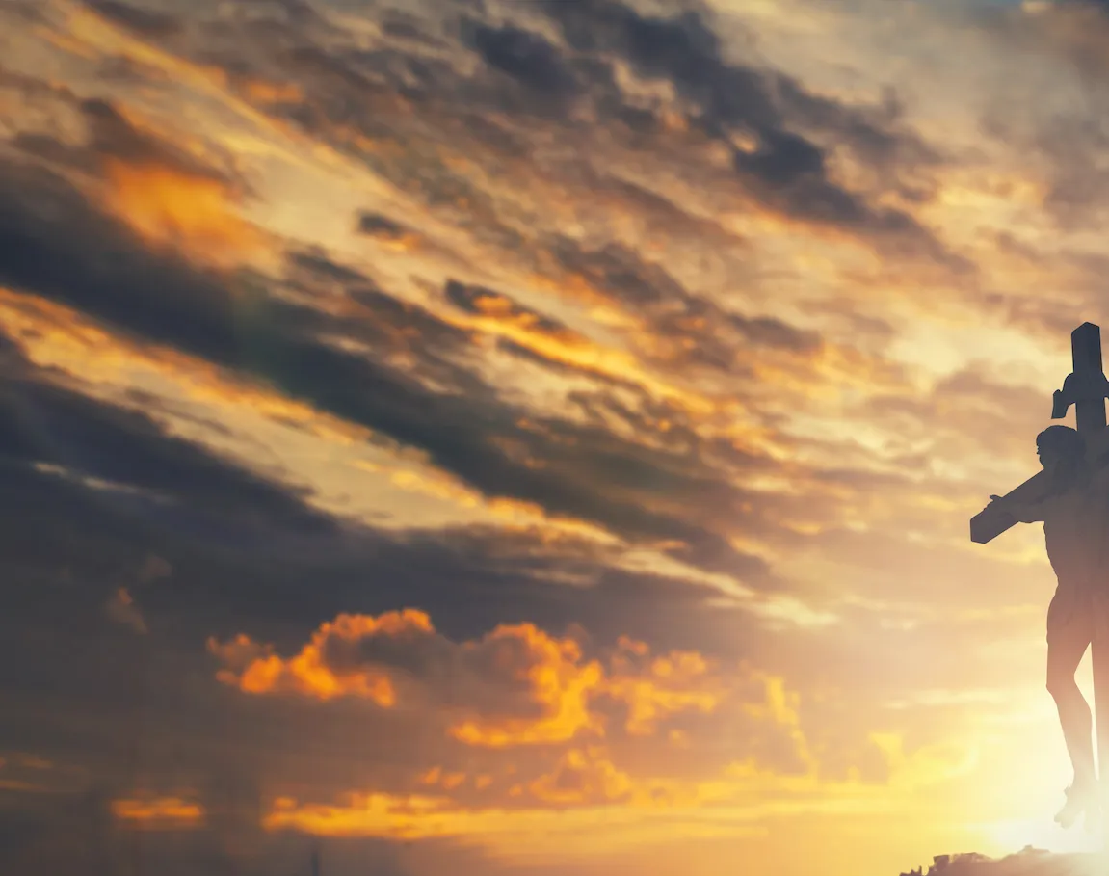
Here I am to Worship

Slide 2
G D Am
Light of the world You stepped down into darkness
G D C
Opened my eyes, let me see
G D Am
Beauty that made this heart adore You
G D C
Hope of a life spent with You

Slide 3
G D
Here I am to worship Here I am to bow down
G C
Here I am to say that You're my God
G D
You're altogether lovely Altogether worthy
G C
Altogether wonderful to me

Slide 4
G D Am
King of all days, oh so highly exalted
G D C
Glorious in heaven above
G D Am
Humbly You came to the earth You created
G D C
All for love's sake became poor

Slide 5
G D
Here I am to worship Here I am to bow down
G C
Here I am to say that You're my God
G D
You're altogether lovely Altogether worthy
G C
Altogether wonderful to me
x2 to Bridge

Slide 6
D G C
I'll never know how much it cost
D G C
To see my sin upon that cross
x3 to Chorus

Slide 7
G D
Here I am to worship Here I am to bow down
G C
Here I am to say that You're my God
G D
You're altogether lovely Altogether worthy
G C
Altogether wonderful to me
x2 to End

Slide 8
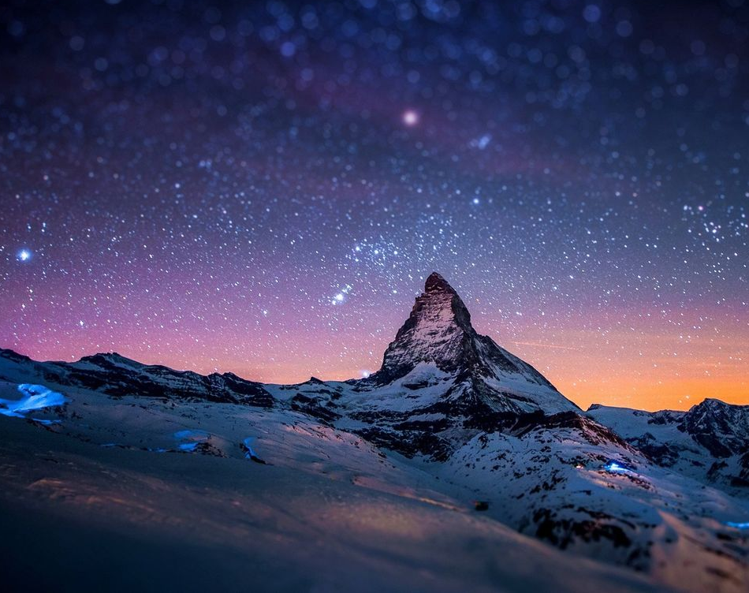
Goodness of God

Slide 9
C F C
I love You Lord Oh, Your mercy never fails me
G Am F Gsus G
All my days, I've been held in Your hands
Am F
From the moment that I wake up
C G Am
Until I lay my head
F G Csus4 C
I will sing of the goodness of God

Slide 10
F C
All my life You have been faithful
F C G
All my life You have been so, so good
F C G Am
With every breath that I am able
F G Csus4 C
I will sing of the goodness of God

Slide 11
C F C
I love Your voice You have led me through the fire
G Am F Gsus4 G
In my darkest night, You were close like no other
Am F
I've known You as a father
C G Am
I've known You as a friend
F G C
I have lived in the goodness of God

Slide 12
F C
All my life You have been faithful
F C G
All my life You have been so, so good
F C G Am
With every breath that I am able
F G Csus4 C
I will sing of the goodness of God

Slide 13
C F G C
Your goodness is running after, it’s running after me
C F G C
Your goodness is running after, it’s running after me
C F
With my life laid down, I’m surrendered now,
G Am
I give You everything
C F G C
Your goodness is running after, it’s running after me

Slide 14
F C
All my life You have been faithful
F C G
All my life You have been so, so good
F C G Am
With every breath that I am able
F G Am
I will sing of the goodness of God
F G Csus4 C
I will sing of the goodness of God
end

Slide 15
All sufficient merit

Slide 16
Am G F C F G
All sufficient merit Shining like the sun
Am G F C F G F C
A fortune I inherit By no work I have done
G Am F C
My righteousness I forfeit At my saviors cross
G Am F G C F
Where all sufficient merit Did what I could not

Slide 17
Am G F C F G
In love he condescended Eternal now in time
Am G F C F G C
A life without a blemish The maker made to die
G Am F C
The Law could never save us Our lawlessness had won
G Am F G C
Until the pure and spotless Lamb had finally come

Slide 18
G Am Em
It is done It is finished
F C
No more debt I owe
G
Paid in full
Am Em F G
All sufficient merit now my own

Slide 19
Am G F C F G
I lay down my garments Any empty boast
Am G F C F G C
Good works now all corrupted By the sinful host
G Am
Dressed in my LORD Jesus
F C
A crimson robe made white
G Am F G C
No more fear of judgement His righteousness is mine

Slide 20
G Am Em
It is done It is finished
F C
No more debt I owe
G
Paid in full
Am Em F G
All sufficient merit now my own

Slide 21
Am G F C F G
All sufficient merit Firm in life and death
Am G F C F G C
The joy of my salvation Shall be my final breath
G Am F C
When I stand accepted Before the throne of God
G Am F G C
I’ll gaze upon my Jesus And thank Him for the cross
F G C
Yes I’ll thank Him for the cross

Slide 22
G Am Em
It is done It is finished
F C
No more debt I owe
G
Paid in full
Am Em F G
All sufficient merit now my own
END

Slide 23
Living Hope

Slide 24
G C / G C CAPO 4th
G D
How great the chasm that lay between us
C Em D
How high the mountain I could not climb
G D
In desperation, I turned to heaven
C D G
And spoke Your name into the night

Slide 25
C
Then through the darkness,
G
Your loving kindness
Em D
Tore through the shadows of my soul
G D
The work is ﬁnished, the end is written
C D G C
Jesus Christ, my living hope

Slide 26
G D
Who could imagine so great a mercy?
C Em D
What heart could fathom such boundless grace?
G D
The God of ages stepped down from glory
C D G
To wear my sin and bear my shame

Slide 27
C G
The cross has spoken, I am forgiven
Em D
The King of kings calls me His own
G D
Beautiful Savior, I'm Yours forever
C D G
Jesus Christ, my living hope

Slide 28
C G D Em
Hallelujah, praise the One who set me free
C G D Em
Hallelujah, death has lost its grip on me
C G
You have broken every chain
D Em D
There's salvation in Your name
C D G
Jesus Christ, my living hope

Slide 29
G D
Then came the morning that sealed the promise
C Em D
Your buried body began to breathe
G D
Out of the silence, the Roaring Lion
C D G (Em)
Declared the grave has no claim on me
C D G
Jesus, Yours is the victory

Slide 30
C G D Em
Hallelujah, praise the One who set me free
C G D Em
Hallelujah, death has lost its grip on me
C G
You have broken every chain
D Em D
There's salvation in Your name
C D G
Jesus Christ, my living hope

Slide 31
C D Em
Jesus Christ, my living hope
C D G
Oh God, You are my living hope
END

Slide 32
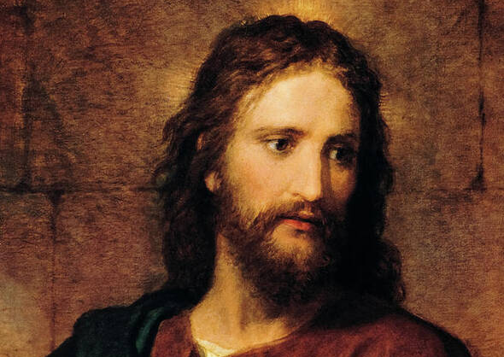
Jesus Paid It All

Slide 33
C
I hear the Savior say,
G C
Thy strength indeed is small,
Am F
Child of weakness, watch and pray,
C G C
Find in Me thine all in all

Slide 34
C Am
Jesus paid it all
C G
All to Him I owe
C F
Sin had left a crimson stain
C G C
He washed it white as snow

Slide 35
C
Lord, now indeed I find
G C
Thy pow'r and Thine alone,
Am F
Can change the leper's spots
C G C
And melt the heart of stone

Slide 36
C Am
Jesus paid it all
C G
All to Him I owe
C F
Sin had left a crimson stain
C G C
He washed it white as snow

Slide 37
C
And when, before the throne
G C
I stand in Him complete
Am F
Jesus died my soul to save
C G C
My lips shall still repeat

Slide 38
C Am
Jesus paid it all
C G
All to Him I owe
C F
Sin had left a crimson stain
C G C
He washed it white as snow

Slide 39
C Csus
Oh praise the one who paid my debt
C Csus
And raised this life up from the dead
C F
Oh praise the one who paid my debt
Dm F
And raised this life up from the dead

Slide 40
C Am
Jesus paid it all
C G
All to Him I owe
C F
Sin had left a crimson stain
C G C
He washed it white as snow

